Slide 1
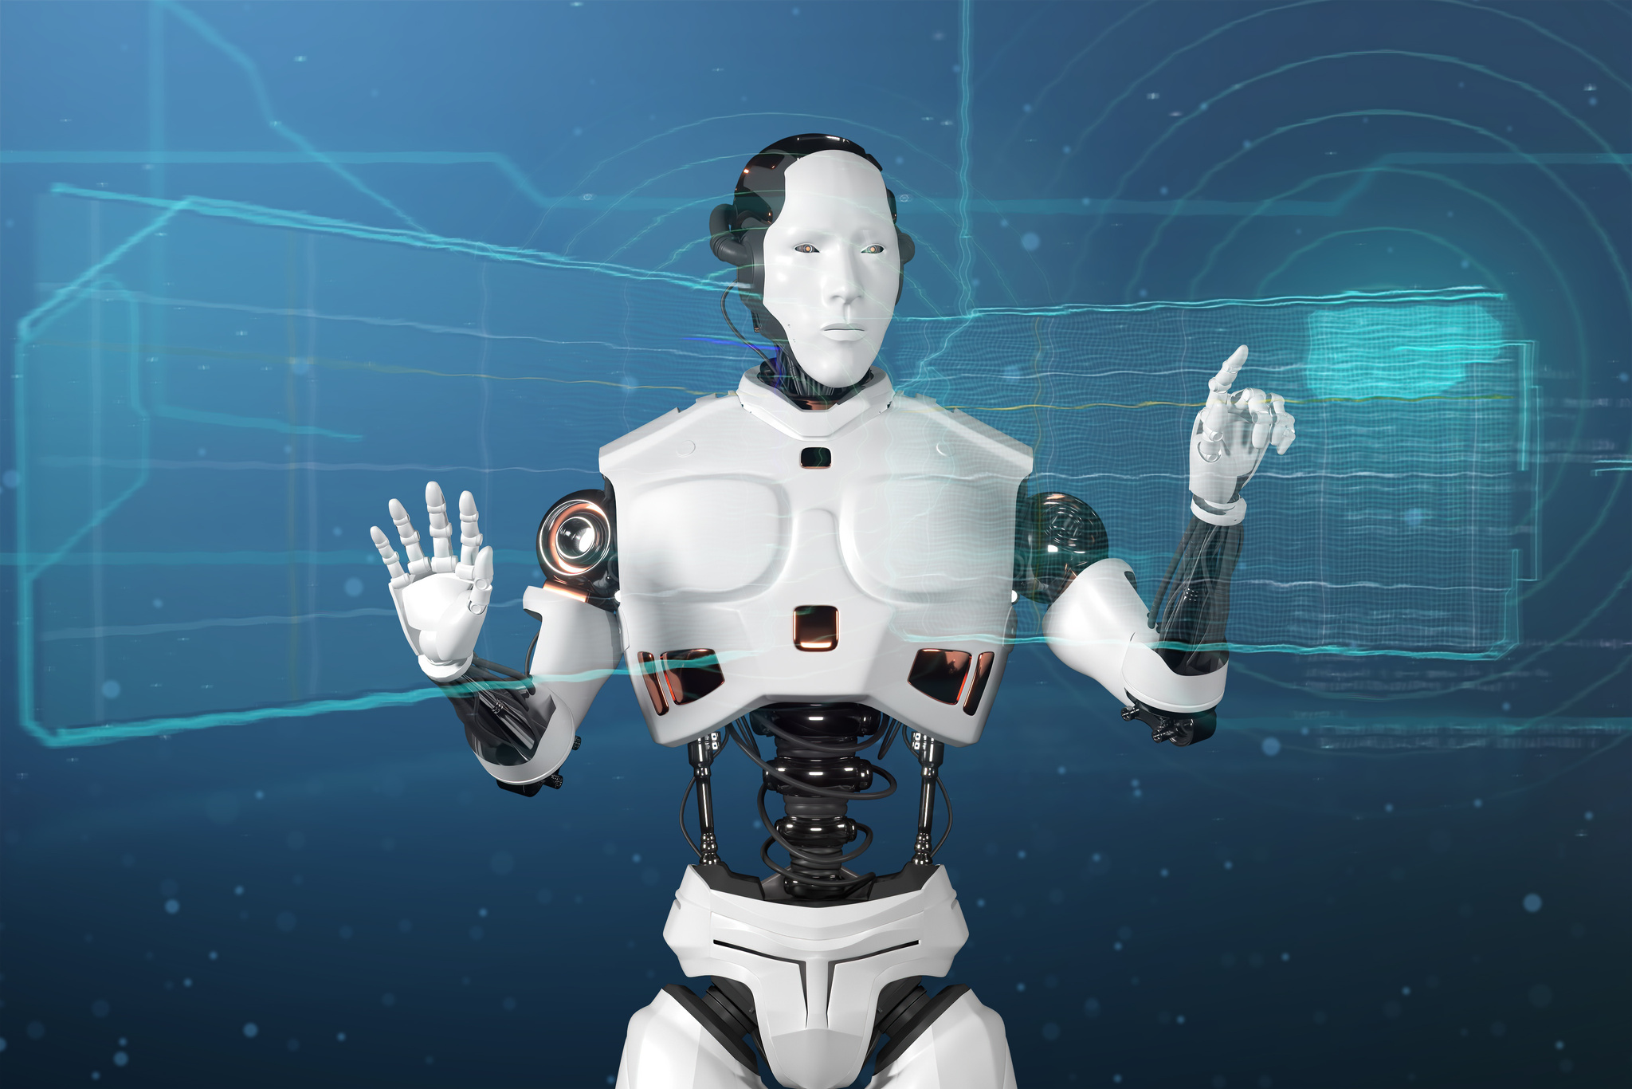

Smart Travel Assistant
Plan Your Journey Easily
ULEFUSA - APTECH Generative AI Hackathon

Slide 2


Meet Your Travel Planner
Introducing our expert travel planner today!
Experience and passion for travel
About
The AI Travel Planner Chatbot is designed to revolutionize the way users plan their travels by leveraging the power of Generative AI. Using Google's Gemini AI model & LangChain, this chatbot offers personalized travel itineraries based on user input regarding their destination, budget, interests, and travel duration.

Slide 3
This chatbot utilizes advanced Natural Language Processing (NLP) techniques to understand and process user queries and dynamically generates tailored travel plans that enhance user experience and engagement. The project integrates Google Generative AI and LangChain libraries to handle the complexities of generating human-like text responses.
AI Travel Planner Workflow

Slide 4
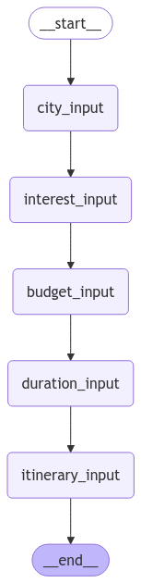
WorkFlow

Slide 5


Smart AI Travel Planner
Your ultimate assistant for organizing seamless and personalized travel experiences.
Our AI Travel Planner uses advanced algorithms to curate custom itineraries that fit your preferences and budget, ensuring every trip is enjoyable and stress-free.

Slide 6


Plan your dream getaway easily
Discover new places with personalized itineraries

Slide 7

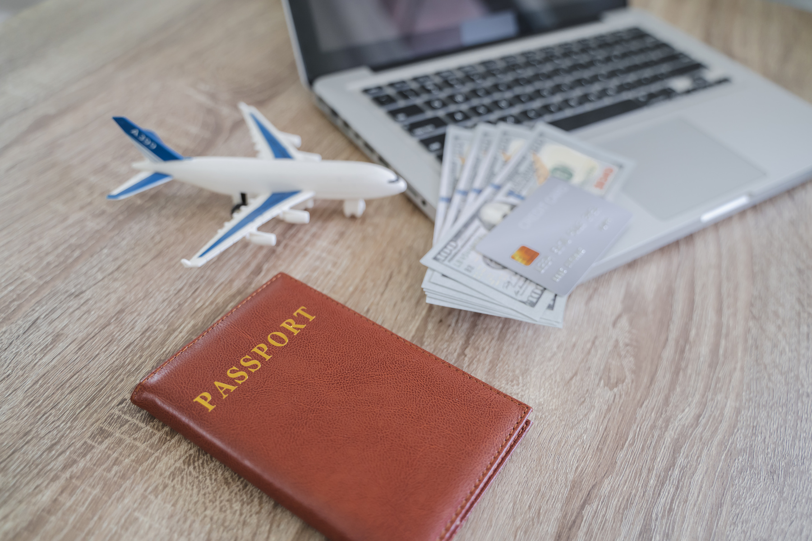

AI Travel Planner Overview
Personalized trip suggestions
Seamless booking process
Real-time updates
Live information for a smooth journey.
Customized based on user preferences.
Effortless integration with travel providers.

Slide 8

Your personal travel assistant at your fingertips!

Slide 9
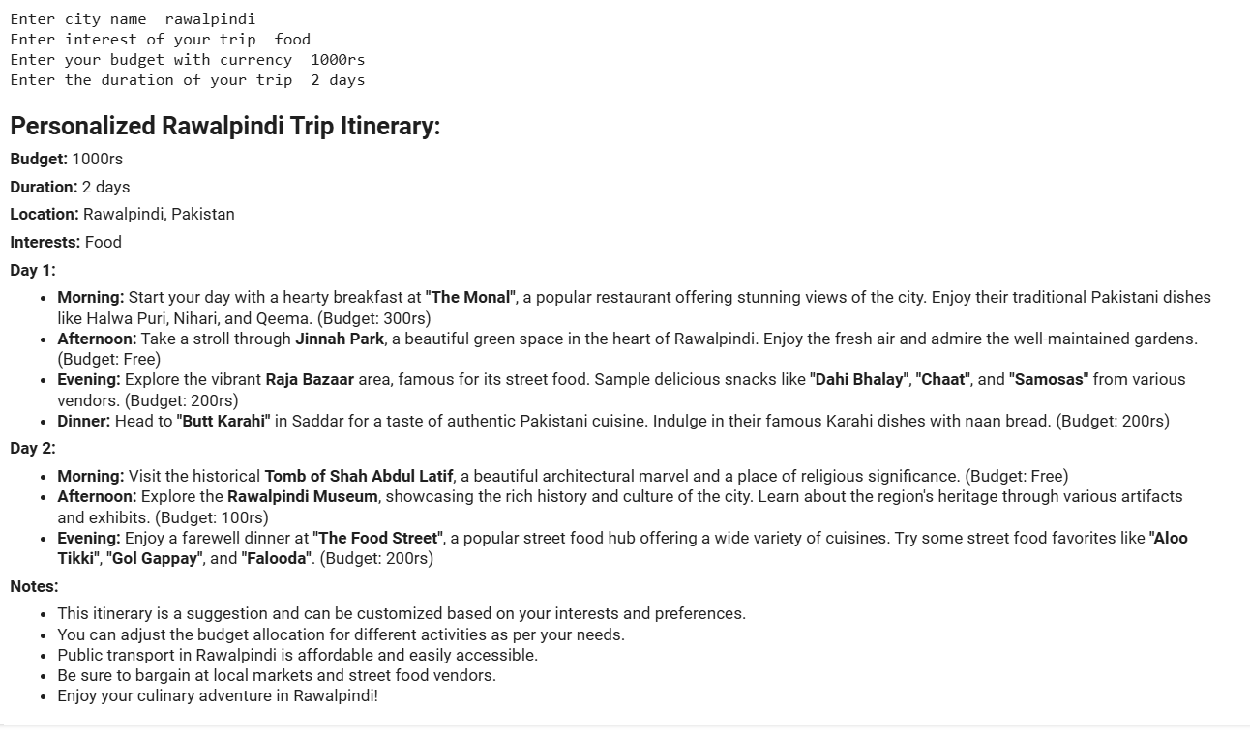
OUTPUT

Slide 10

Smart AI Travel Assistant
Personalized travel recommendations
Real-time travel updates
Stay informed with instant notifications on changes.
Receive tailored suggestions based on preferences.
Intuitive itinerary planning
Seamless booking process
Easily organize trips with user-friendly tools.
Quickly secure reservations with one-click options.

Slide 11

Safe travels!

Slide 12
Team
Team Leader
Name: Sohaib Aamir
Unique ID: 6135
Team Members
Shifa Saeed
Unique ID: 30573
Sikandar Ahmad
Unique ID: 31516
Sarmad Shahid
Unique ID: 30409
Team Members
Junaid Iqbal
Unique ID: 30593
Mehboob Elahi
Unique ID: 30653

Slide 13

Thank you all!
Sohaib Aamir | GitHub

